Slide 1
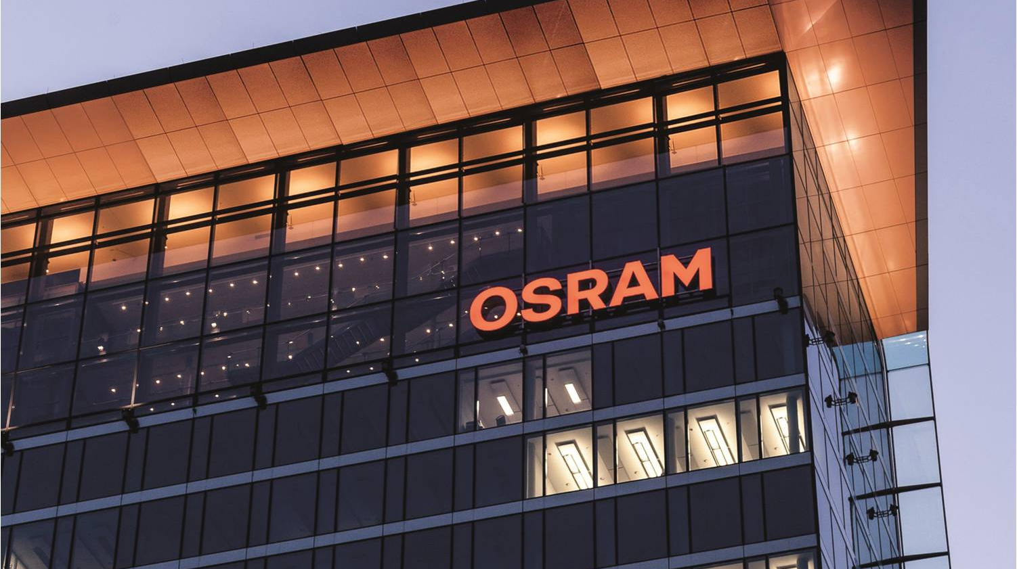



Pac-Lite Hardware Benchmark
Automotive
Devlin Paddock | 06/12/19
Light is OSRAM

Slide 2
Why do we need Pac-Lite
Camstar
A Manufacturing Execution System.
Communicates primarily in XML UDP packets
Receives information directly from Pac
Pac
A Process Automation Control software
A Machine abstraction layer that allows communication between machine controls and Camstar
Doesn’t mesh well with legacy machines
$ 1000 license per machine
Pac-Light
Black box to allow legacy machines to communicate with Camstar in the absence of an MDE
Provides basic functionality for Camstar modules without the time and expense of a full blown MDE system but lacks the features of a full MDE system
Camstar
Engineering Database
TCP XML
ActiveMQ
Pac
Pac Lite
Packetized data
MDE
Digital IO
UDP Packet
Machines
Legacy Machines

Slide 3
Pac-Lite Project Requirements
Report Machine Output
Up/Down status
Good/Bad part output
Machine indexes
Empty head
What product is being produced
Enable power on
10 Input to pac-lite
Display Machine Status
Status stack light
Easy to use HMI
4 outputs from pac-lite
HMI
Product selection- NAED
Defined DT button
Self managed NAED list
Display diagnostics.
Scope of the project in orange
Sample UI on a Siemens HMI
Camstar
MQTT Packets
Pac Lite
Pac
MDE
Digital IO
New NAED
Enter
Cancel
Sort
Legacy Machines
Machines
Notes:
Reduce slightly.

Slide 4
Proposed Pac Light Architectures
One CPU per machine solution
Provide a local HMI for user input, information and diagnostics display.
Easy for E-Techs to troubleshoot
Reliably record output of a single machine and report it to Camstar
One CPU per three machine solution
Integration with up to three target machines
Provide up to four remote HMIs for user input, information and diagnostics display.
Reliably record output of up to three machines and report it to Camstar as separate machines.
One CPU per line solution
One remote IO bundle per machine.
Provides one display at beginning or end of line
Reliably record output of up to 32 machines and report it to Camstar as separate machines.
Pac Lite
Machine
HMI
Pac Lite
Machine
HMI
Machine
HMI
Machine
HMI
Pac Lite
HMI
HMI
Machine
Machine
Machine
Notes:
//Add original project def slide to backup slides. Add backup slides section after final slide.
//look into possibility of 1 HMI instead of 4. restriction was on HMI’s I believe that it was limited to 128 IO expansion at 8 per remote IO max.
//Check out support for communicating Between two plc’s in the 1200 series to allow switching the NAED at one location instead of two.
Replace diagrams on right with images of siemens pc’s
Shift slide 10-11 in as well

Slide 5
Architecture Hardware
Scada
Single machine architecture
Limited by IO and HMI
1212C
Single, Three machine, or line based architecture.
Limited by number of HMI’s.
Siemens remote IO for multiple machines.
1510SP
Four Machines, or line based architecture
Limited by number of HMI’s
No integrated IO, requires remote IO or expansion.
Pac Lite
Machine
HMI
Pac Lite
Machine
HMI
Machine
HMI
Machine
HMI
Pac Lite
HMI
HMI
Machine
Machine
Machine

Slide 6
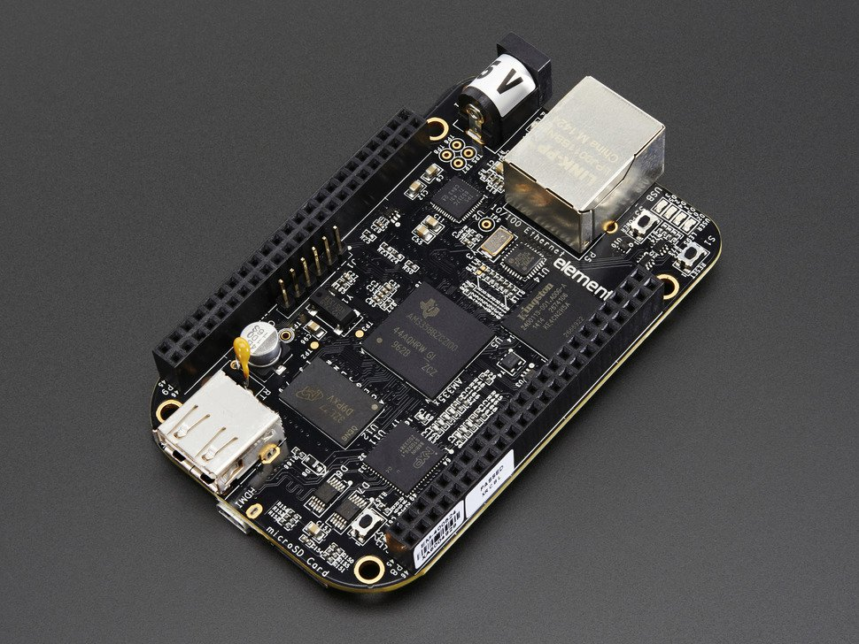
SCADA Box ,One Machine solution
Operating System:
An IPC Linux operating system.
Higher level language allows for more communication flexibility
Hardware
Beagle Bone Black base
4 GB internal storage
Relevant IO
USB, Micro HDMI,8 digital in, 8 digital out and 8 analog in.
HMI
Freeboard Remote HMI for administration
Node Red Local HMI for management of the machine and NAED selection.
Outputs over HDMI allowing for much more freedom in
display choices.
IO
Local HMI
Free Board
C/C++
Gamma
Middleware
Node Red
Also Supports High chart and Xibase Integration

Slide 7
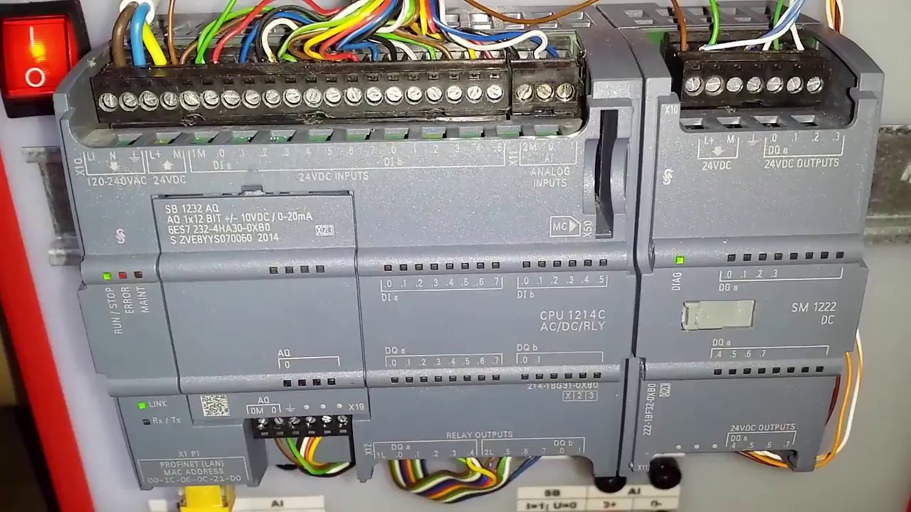
Siemens Products -Generic
Software
Developed in Step7 or Tia Portal.
Scan Based OS
Lower level control.
Requires HMI Displays capable of rendering themselves.
Hardware
Limited number of connections that has to be split between Web, IO, HMI, Etc.
Expandable by IO and communication Modules.
Communication: Serial, Profibus, Profinet, Etc.
IO: Timers, PWM output, analog, Relay, Etc.
Remote IO
Other Controllers
“Smart” HMI
Profinet Connection
IO
CPU
Memory
Notes:
Go into hardware more indepth glossed over before

Slide 8
CPU solutions
1212C
8 inputs and 6 outputs integrated
Supports 3 HMIs
Remote IO Via Profinet
Lacks STL, and Graph support
Lower cost than 1500 series. Larger footprint
Slower operation speeds.
1510SP
No integrated IO
Supports 4 HMIs
Remote IO via Profinet
Supports STL, and Graph
More expensive than 1200 series
Fast operation speeds

Slide 9
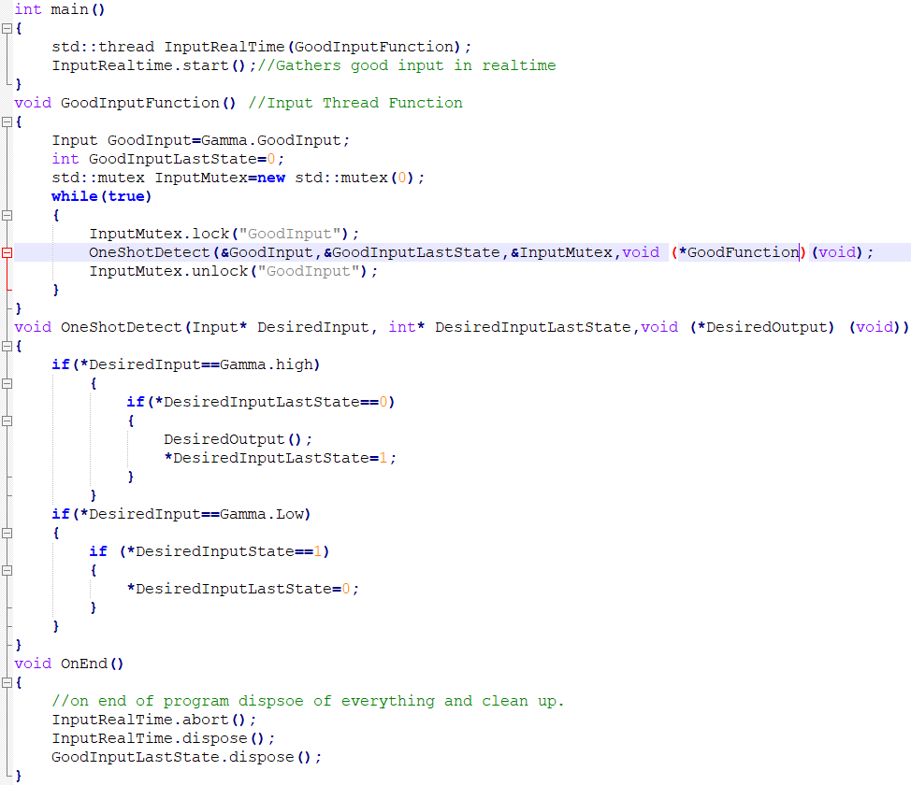
SCADA box Benefits
Higher Level Control:
Easy deployment
Administrative Free Board
Local Node-Red HMI
Different communication types
MQTT,HTTPS,UDP,TCP Etc.
Remote machine control
Can poll servers for BOM data or machine lock signals
Useful for later Projects
Adds a lot of resident IO
2 Serial, 4 thermal interfaces, 8 analog Inputs, IDRA receiver
Can be reused for other projects
Could addon Environment monitoring
Misc.
Web based management
35% cheaper than 1212C and 22% cheaper than 1510sp across 6 machines

Slide 10
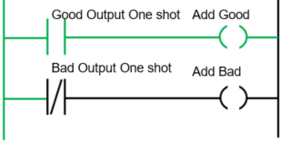
Siemens Solution Benefits
Better Maintainability:
Local Factors
Local Experience
Replacement Parts
Common Development Environment
Better Forums
IO Expansion
More IO available for more in depth error reporting
Communication Modules
Ability to add Serial, Profinet, Ethernet, Profibus, Etc.
Misc.
Easy to deploy
Easy to troubleshoot
Durability tested to -20C, and 15g shock, IP20 protection rating

Slide 11
Cost Breakdown
 | 1212C Single | Scada Single | 1510 Multi | 1510 Line
Cost for 1 machine | $830 | $536 | $1,730 | $2,077
Cost for 4 Machines | $3,320 | $2,144 | $3,995 | $3,301
Cost for Straight Base | $4,979 | $3,216 | $6,480 | $4,117
Cost over X machines
Notes:
Redo page less detail on makeup.

Slide 12
Category Comparisons
Scada:
Maintainability
Less local experience
Poor documentation
Adaptability/software flexibility
Two way MQTT communication, and ability to run SQL queries.
1212C:
Maintainability
Better local experience
More industrialized
Siemens documentation
Adaptability/Software Flexibility
IO Expansion allows more descriptive fail reporting
1510sp:
All benefits of 1212C listed.
Adaptability/software flexibility
Can support more machines
Supports Graph and STL programming
Better
Notes:
Wrong slide not sure how it got in here fix
Organize better and displayin a ordered way based of weight.
Color the tops with which color they are and put in same order as bottom

Slide 13
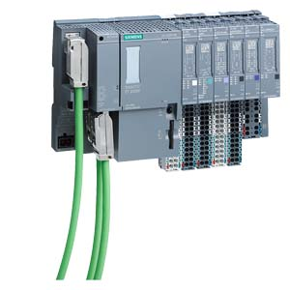
Hillsboro Recommendation
Siemens PLC 1510sp Line solution
Environment
Local experience
Common development environment
Easy troubleshooting
Designed for an industrial setting
Diverse Hardware
More IO can allow for more complex error reporting
Benefits of Scada IO can be added separately
Flexible setup
1 box is capable of up to 32 machines or 2 lines.
Support
More likely to get software/hardware support for longer (three year newer release date)
Better support for MQTT
Remote IO allows for a new CPU when this one loses support.
Pac Lite
HMI
HMI
Machine
Machine
Machine
Notes:
Wrong slide not sure how it got in here fix

Slide 14
Thank you.

Slide 15
Backup Slides

Slide 16
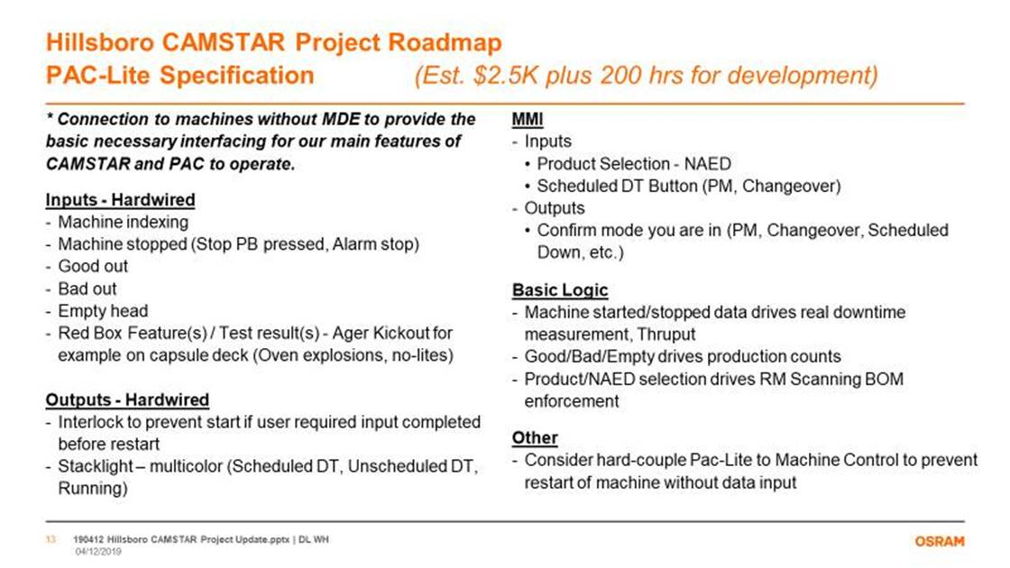

Slide 18
Backup Slides

Slide 19
Cost Breakdown
CPU | Cost Per Device | Cost Per New Machine | Cost per 4 | Straight Base | CPU cost | Accessory Cost
Siemens 1212C | $738 | $738 | $2,952 | $4,427 | $232 | $506
Siemens Using Remote IO 1510sp | $1,523 | $706 | $3,641 | $5,870 | $816 | $706
SCADA Resistive Touchscreen keyboard Mouse | $527 | $527 | $2,108 | $3,162 | $430 | $97
 | HMI Cost | storage | Minimum Expansion
Siemens 1212 | $347 | $159 | $0
Siemens Using Remote IO 1510sp | $347 | $159 | $200
SCADA PIResistiveTouchscreen | $97 | $0 | $0
Cost For 4 Machines (best case for 1510)

Slide 20
Score Breakdown
 |  | Rating of Importance to Customer |  | 5.8 | 8.5 | 6.0 | 10.0 | 10.0 | 10.0 | 6.7 | 10.0 | 5.0 | 10.0 | 3.7 | 3.7 | 5.0 | 6.7 | 1.7
 |  |  |  | 1 | 2 | 3 | 4 | 5 | 6 | 7 | 8 | 9 | 10 | 11 | 12 | 13 | 14 | 15
 |  |  |  | MQTT Support | Ability to heavy tasks without impacting realtime applications | Supports a Local HMI per machine | Experience of local engineers and E-Techs with the hardware/ software | Ease of remote administration | Repairability/ replacability | Commonly installed development environment | Software and Hardware documentation | Resident IO | IO Expandability | Complexity of initial setup | Adding restrictions from external software | support for multiple machines | report Complexity for part failure reasons | Cost | Total
Area of opportunity | Description of Improvement | Process Input
Scada Single Machine Solution | Scada Box reporting to camstar with a local HMI Built in Node red and a remote administrative site in FreeBoard |  |  | 10 | 10 | 10 | 1 | 10 | 1 | 1 | 1 | 10 | 1 | 10 | 10 | 1 | 1 | 10 | 501.7
1212C single Machine solution | 1212C Siemens PLC Reporting a single machine to camstar with a local HMI |  |  | 5 | 5 | 10 | 10 | 5 | 10 | 10 | 10 | 10 | 10 | 10 | 5 | 1 | 10 | 5 | 833.3
1510SP Single Machine solution | 1510sp Siemens PLC Reporting a single machine to camstar with a local HMI |  |  | 5 | 5 | 10 | 10 | 5 | 10 | 10 | 10 | 10 | 10 | 10 | 5 | 1 | 10 | 1 | 826.7
1510SP Multi Machine Solution | a 1510SP CPU with remote IO, and HMI spread to each machine it is connected to. Limited to 4 machines |  |  | 5 | 5 | 10 | 10 | 5 | 10 | 10 | 10 | 10 | 10 | 5 | 5 | 5 | 10 | 5 | 835.0
1212C Multi Machine Solution | a 1212C with remote IO, and HMI spread to each machine it is connected to. Limited to 4 machines |  |  | 5 | 5 | 10 | 10 | 5 | 10 | 10 | 10 | 10 | 5 | 5 | 5 | 5 | 10 | 5 | 785.0
1510SP Line Solution | a 1510SP CPU with remote IO spread to each machine on a line. With 1 HMI at the end and beginning of the line only. Can support up to 32 machines. |  |  | 5 | 5 | 1 | 10 | 5 | 10 | 10 | 10 | 10 | 5 | 5 | 5 | 10 | 10 | 10 | 764.3
1212C Line Solution | a 1212Ccpu with remote IO spread to each machine on a line with 1 HMI at the end and beginning of the line only. Can support up to 32 machines. |  |  | 5 | 5 | 1 | 10 | 5 | 10 | 10 | 10 | 10 | 5 | 5 | 5 | 10 | 10 | 10 | 764.3

